Slide 1

Smart Home Automation System
App Based Smart Room Controlling System DIY Team Project IIT Kharagpur
This Photo by Unknown author is licensed under CC BY-SA-NC.

Slide 2
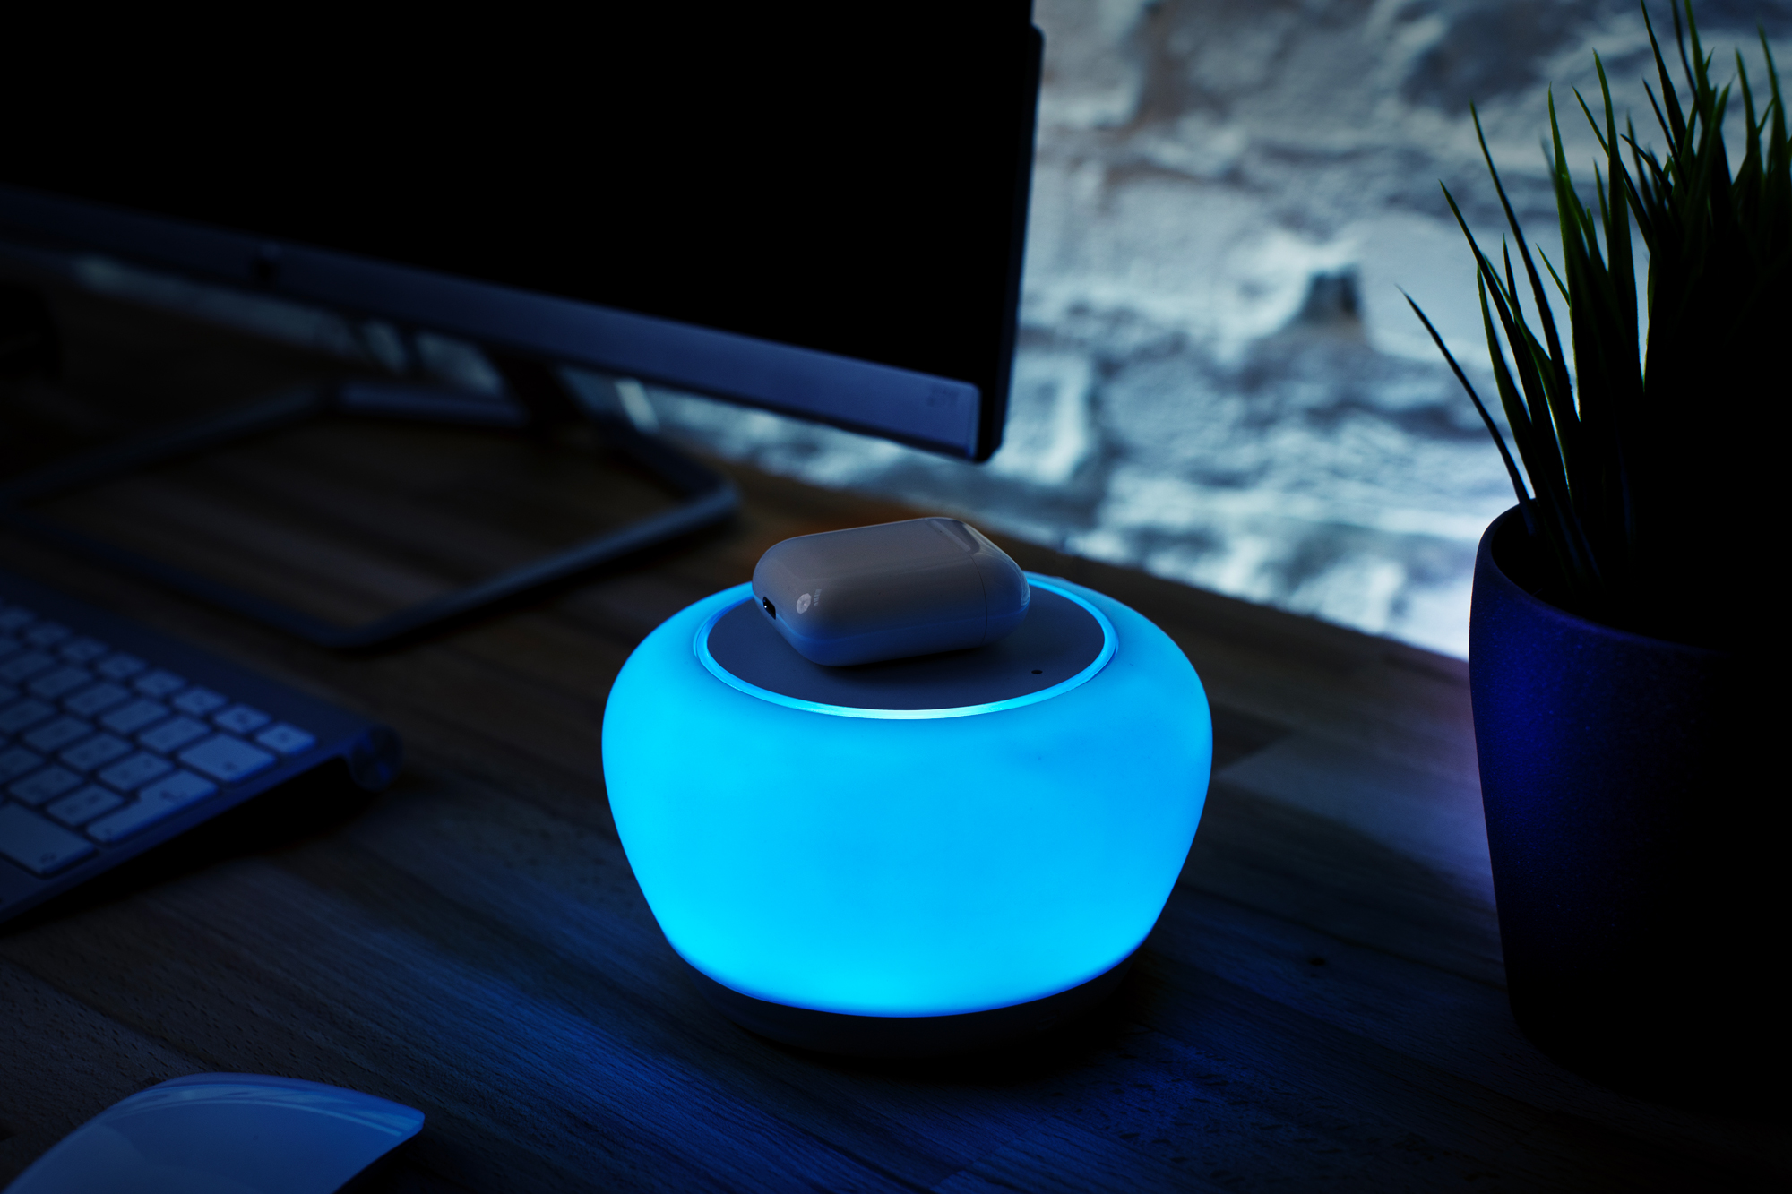
Project
Presented By:
Challa Naga Sujan (21CE10015)
Rounak Das (21CE10055)
Amitabh Raj (21AE30003)
Mohit Kumar Meena (21CE10035)
Rishav Chakraborty (21AG30030)
Project Supervisor: Arindam Mandal
This Photo by Unknown author is licensed under CC BY-NC-ND.

Slide 3

Overview
Topics for discussion:
→ Objective of the Project
→ Voice control your Home
→ Control Home from smartphone
→ Cheaper than competitor Smart Home devices
→ World's first "Offline" Smart Home Controller
→ Required components and Circuit Diagram
→ How our Smart Room Controller worked
→ How Amazon Echo devices works
→ Security and Privacy
→ Future Scopes
→ Conclusion
→ References

Slide 4
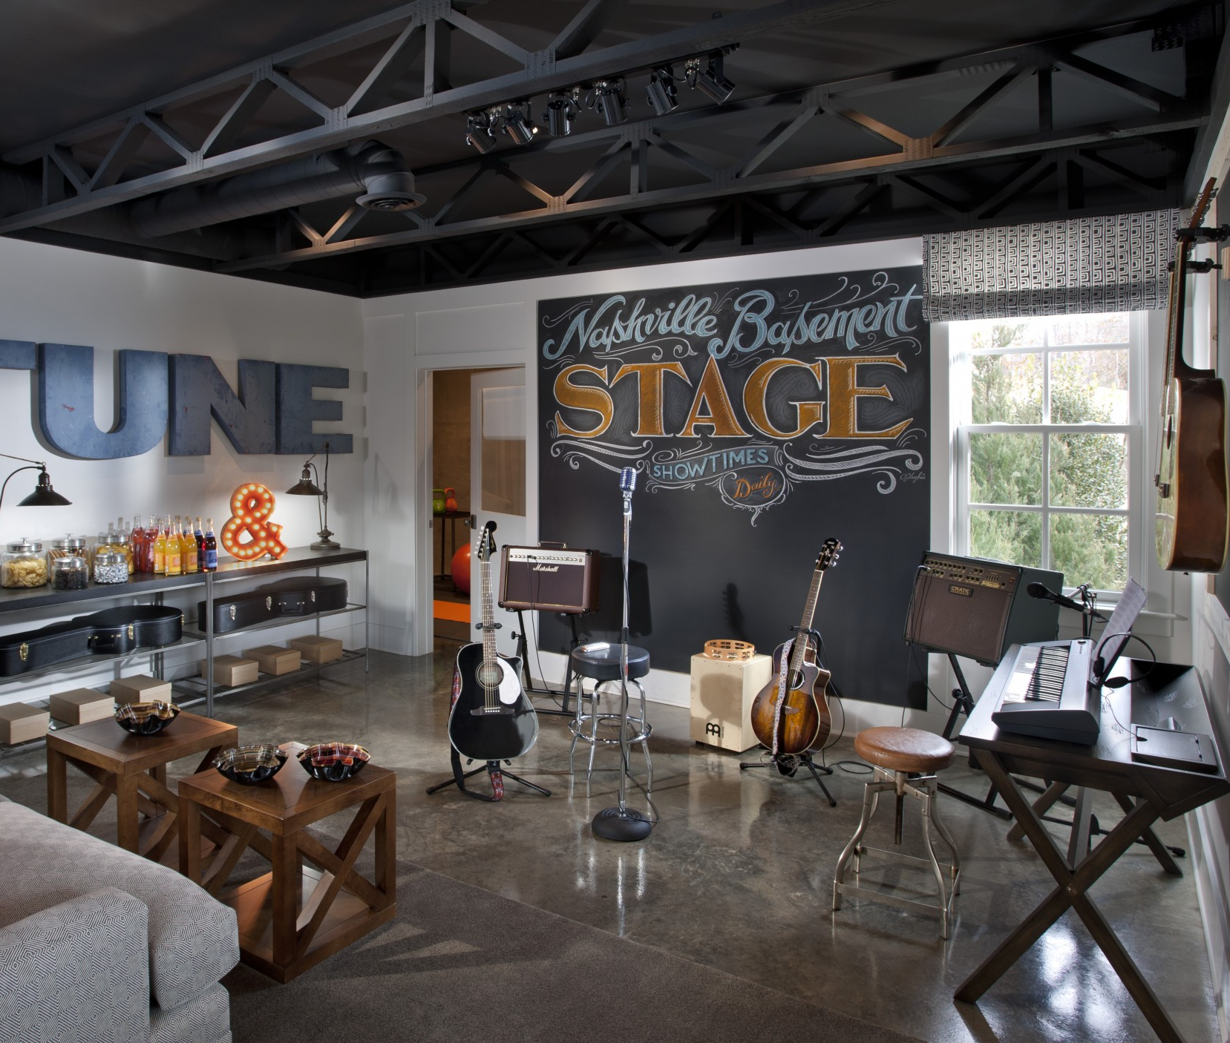
Objective
Idea is to make a system that helps controlling home
appliances in a smart, active and fun way.
Nowadays the energy is wasted by modern people as they
don't care much about energy. This should contribute a small
effort to save energy for future.
We know maintaining the security level for home is very
crucial. So, here we have discussed about the Smart Home
development.
This Photo by Unknown author is licensed under CC BY-NC-ND.

Slide 5
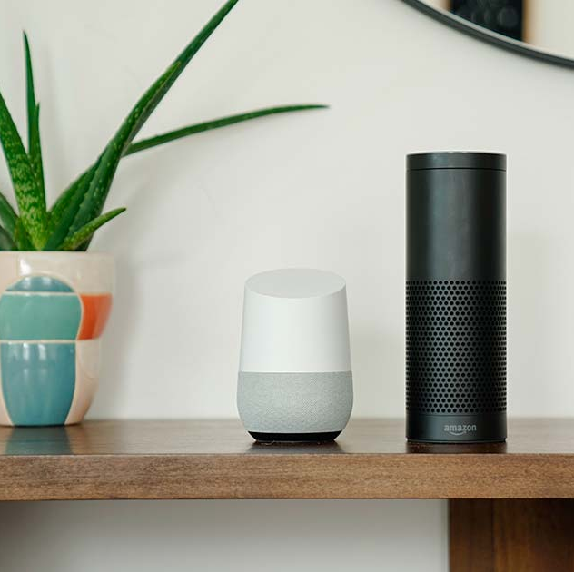
Voice Control your Home
Use commands like :
"Turn on Bedroom Lights" or "Turn off Bedroom Lights" to turn your Bedroom Lights On or Off.
Use commands like "Turn on Dining Room Fan" or "Turn off Dining Room Fan" to Turn your Dining Room Fan On or Off.

Slide 6
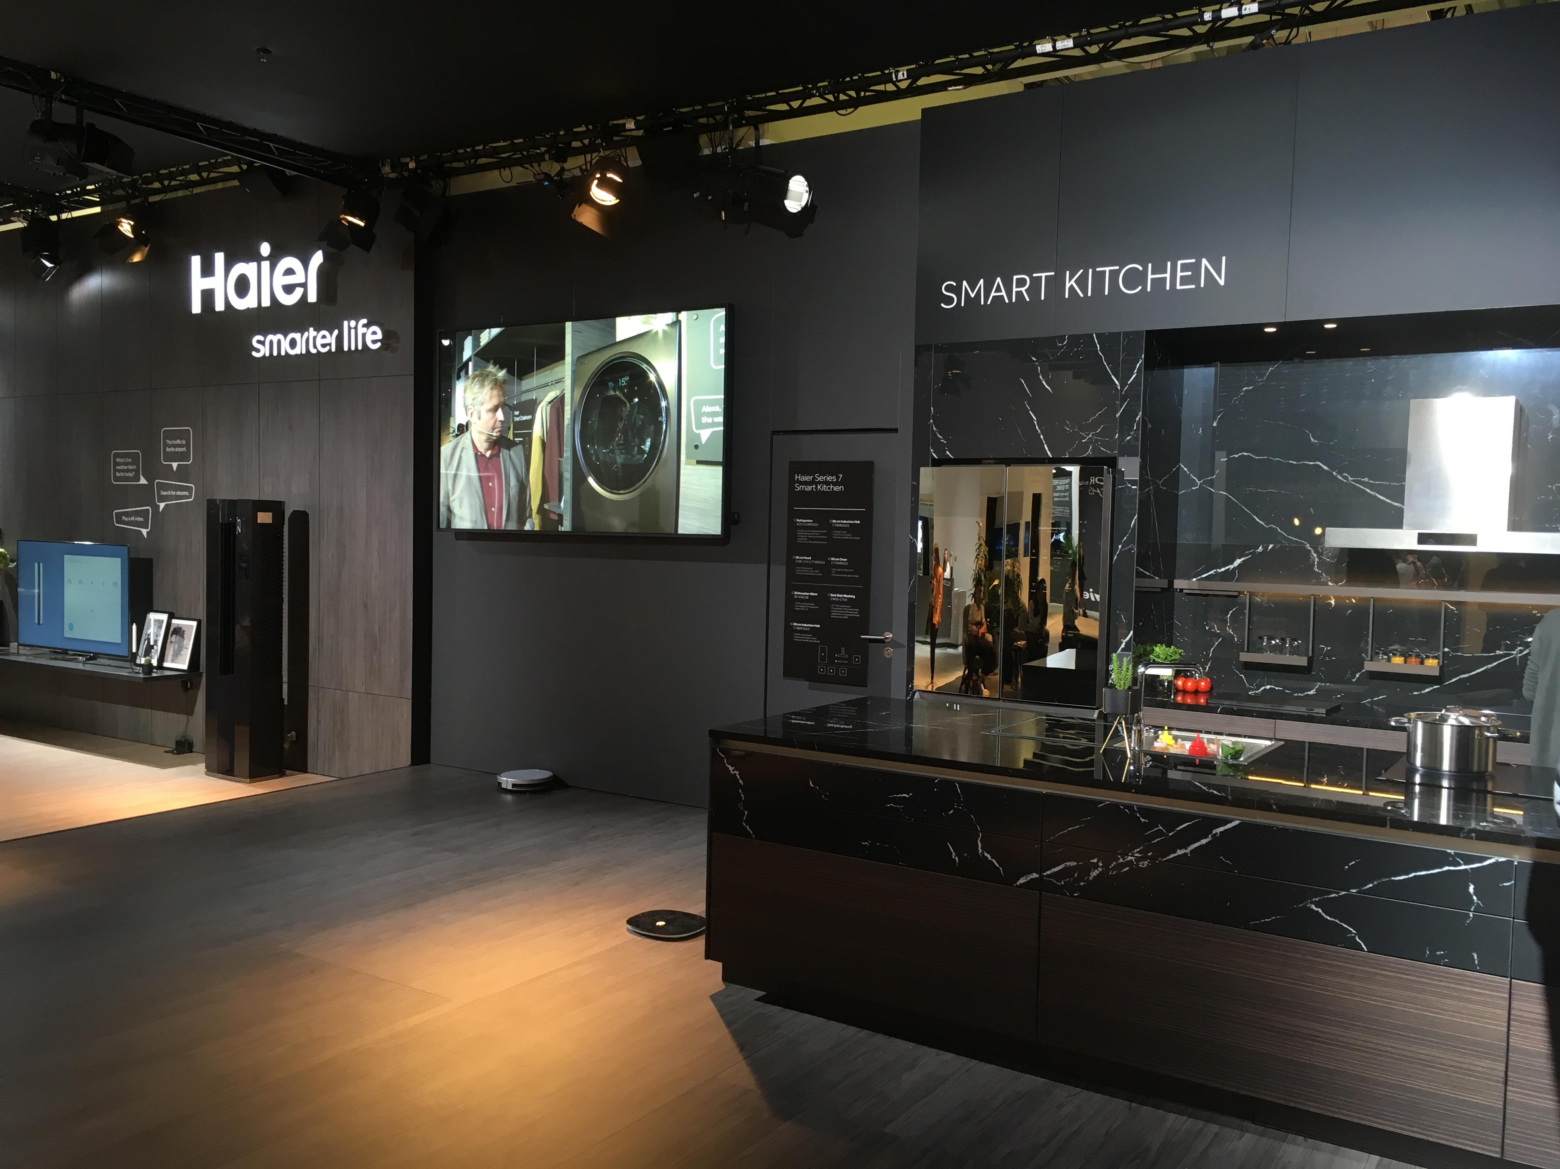
Control your Home from your Smartphone
It works with the most used digital device used by us. It works from our Smartphone.
It uses Google Voice Assistant and sends out voice commands to Smart Room Controller
Using Bluetooth technology.
This Photo by Unknown author is licensed under CC BY-NC-ND.

Slide 7

Cheaper than Google Home or Amazon Echo amazon
It's build with Arduino, Relay Controller, Bluetooth Module and some simple electronic devices. Therefore its way cheaper to build.
It can be connected to any home appliances with the relay controller to control it. No more expensive Phillips Hue lights are
required to make your home Smart Home.

Slide 8

It works Offline !
It works Offline, because Privacy is our main concern.
It's World's first "Offline" Smart Home Controller.
It works even when you don't have an active Internet connection.
It doesn't listen to you private conversations.
It doesn't upload your personal information like contacts, messages, photos, videos etc. data to cloud.

Slide 9

Required Components
Arduino Uno or Genuino Uno x 1
Relay Controller 4 / 8 Channel x 1
Bluetooth Module HC-05 x 1
16x2 LCD Screen with I2C Module x 1
DHT11 Temperature & Humidity Sensor x 1
Light and Fan x 2
Power Supply
This Photo by Unknown author is licensed under CC BY.

Slide 10
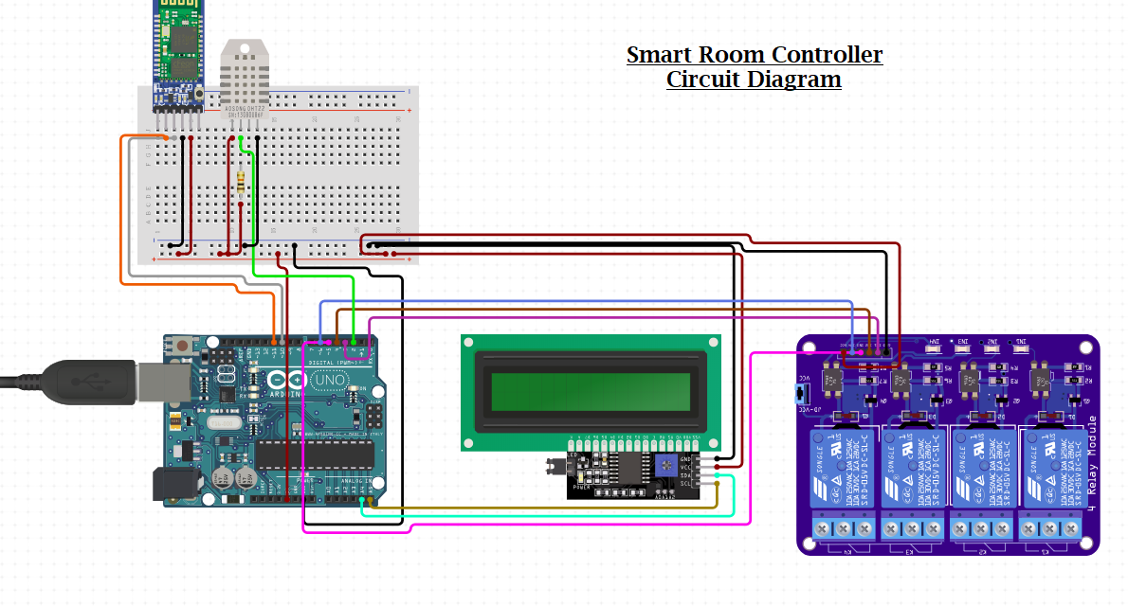

Slide 11
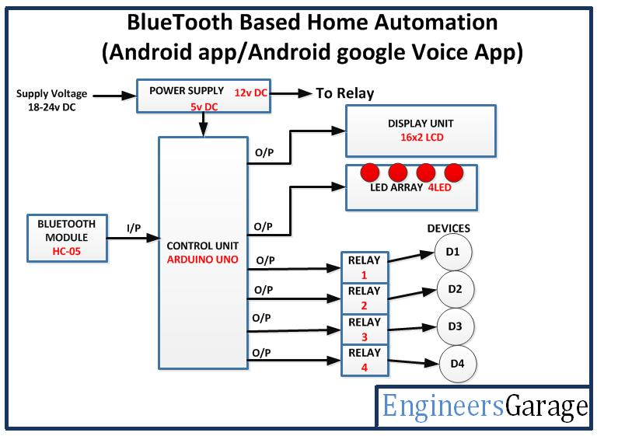
How our Smart Room Controller works

Slide 12
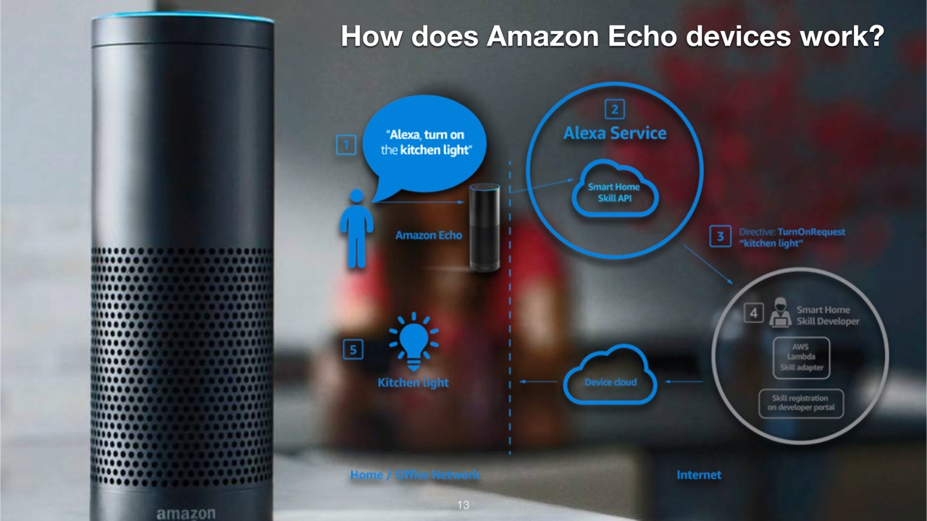

Slide 13

Security and Privacy
We believe Privacy is fundamental human right. A lot of people are worried that voice assistants like Amazon's Alexa, Apple's Siri or the Google. Assistant are spying on us at home.
It's always listening
Your conversions are recorded
They're Susceptible to Hacking
It Introduces New Forms of Advertising
You're Helping Amazon Sell More to You
If you're not paying for the product, you're not the customer, you're the product being sold.
Google knows which places you've visited since the time you started using a smartphone and which route you've taken to get there and in how much time you've reached there.
This Photo by Unknown author is licensed under CC BY-SA-NC.

Slide 14

Future Scope
To connect more number of devices.
Make it available for disables in the house.
Make it available for every home and save electricity on large-scale.
Fabricate the whole circuit in an IC and make an affordable tiny package.
This Photo by Unknown author is licensed under CC BY-ND.

Slide 15
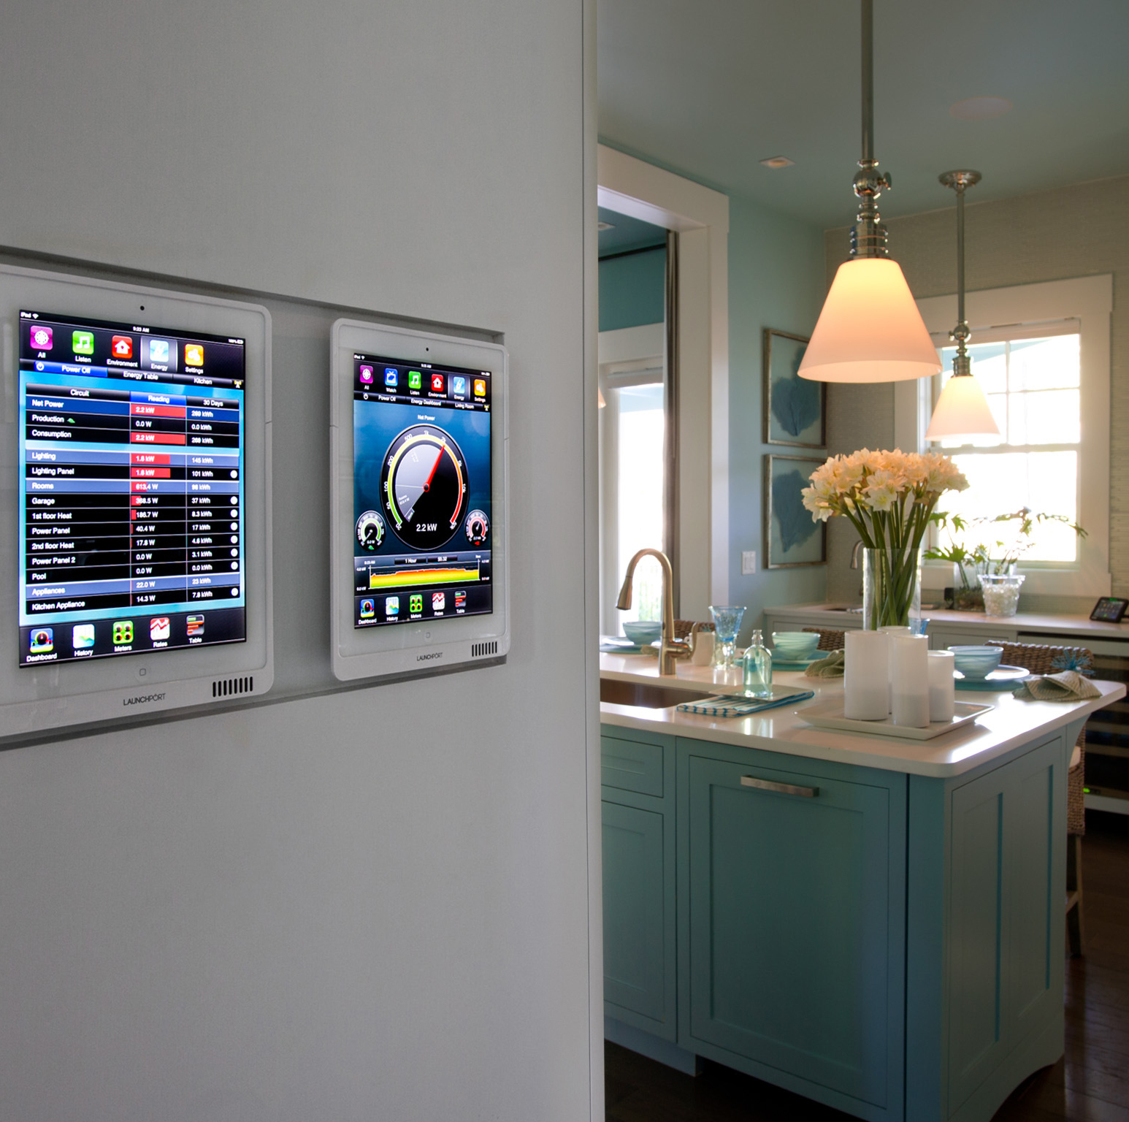
Conclusion
A smart control system has been designed and developed towards the implementation
to effectively control the electrical appliances usage and save energy.
This Photo by Unknown author is licensed under CC BY-SA.

Slide 16

References
https://www.ijert.org/bluetooth-based-home-automation-using-arduino
https://create.arduino.cc/projecthub/embeddedlab786/how-to-make-arduino-based-home-appliance-control-be33f4
https://www.youtube.com/watch?v=CpUVssHPm_s
https://www.youtube.com/watch?v=gpB4600keWA
This Photo by Unknown author is licensed under CC BY-NC-ND.

Slide 17
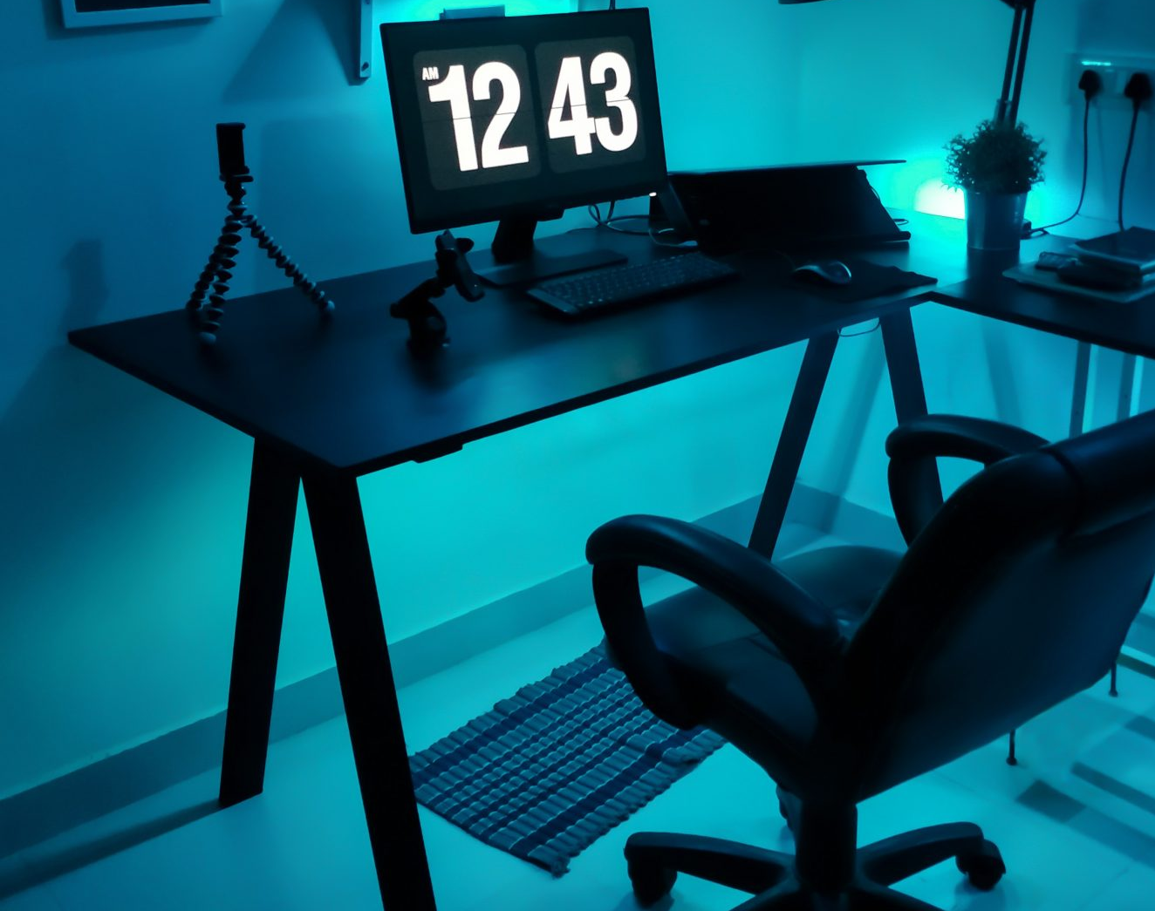
So , let's build smart home
Thank You
This Photo by Unknown author is licensed under CC BY.

